Slide 1
Bolted System: Auto-deployment Cloud Project
Vidya Anandamurali
Pei Jia
Yuxi Jiang
Jiangnan Zou

Slide 2
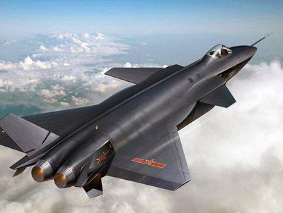
Project Introduction
Security sensitive Tenants like Air Force are not able to use public cloud due to security concerns.
e.g., previous tenant might have compromised the node’s firmware
Bolted system is a solution for abling such tenants to use public cloud

Slide 3
Bolted System
HIL
Provide nodes and networks isolation during key stages
Modified to perform attestation on firmware
BMI
Set up nodes by provisioning software on them
Slightly modified to enable attestation
Keylime
Monitoring security of node before and after deployment
Leverage TPM to validate the integrity of software on cloud
Orchestration Engine
coordinate each component to deploy the client node

Slide 4
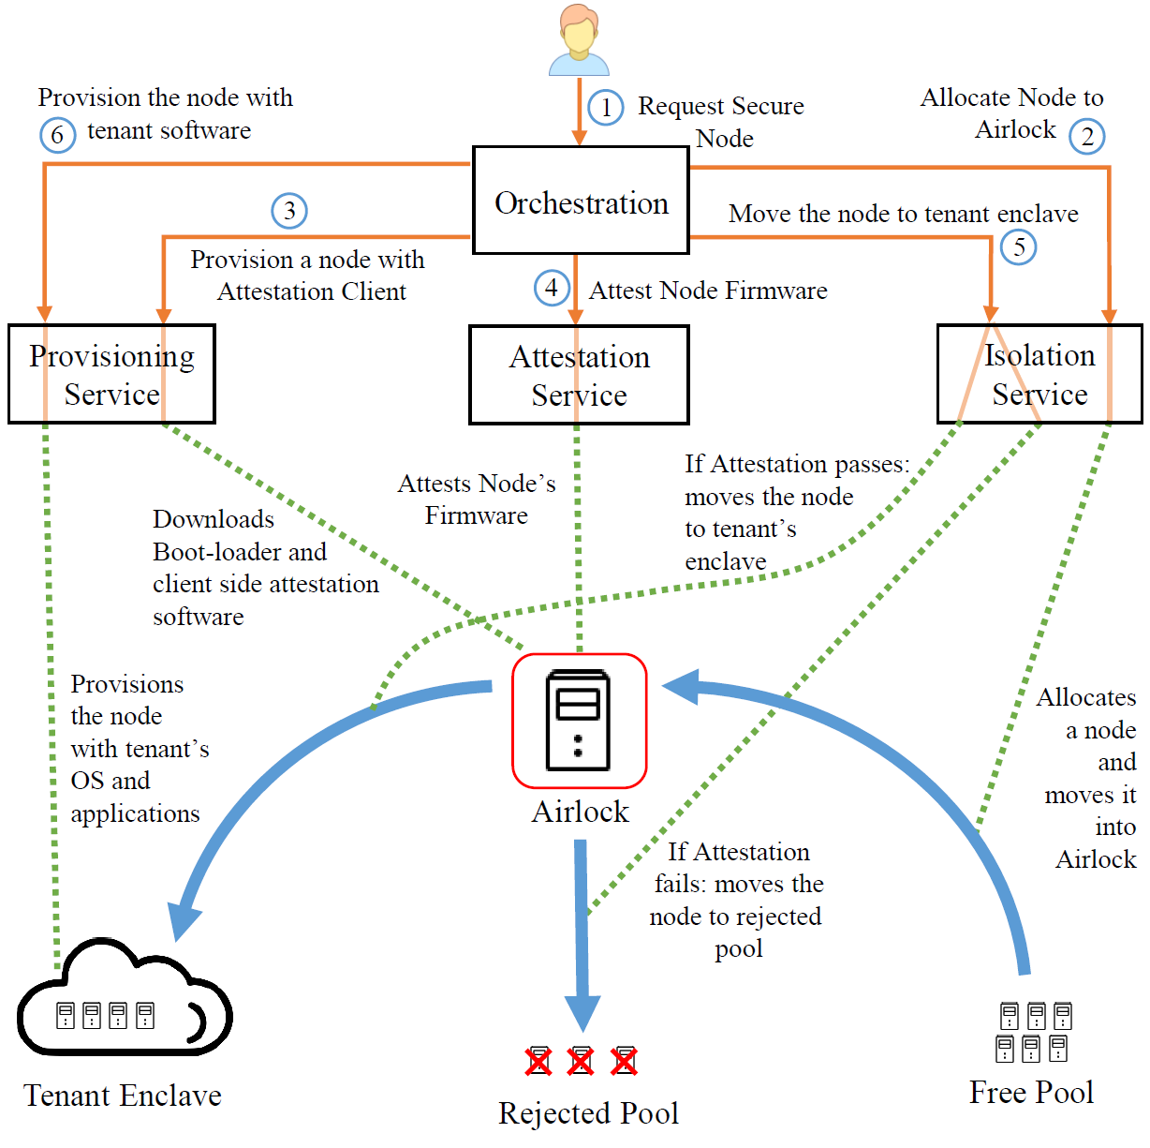
Working of the System

Slide 5
Project Description and Goal
Automate the deployment of Bolted which consists of:
Installation and configuration of each component of the Bolted system (HIL, BMI, Keylime and orchestration)
Integrating all the components together
Bolted system should be able to be installed on any cloud platform

Slide 6
Use Case
As a cloud provider, I want to deploy Bolted System on my cloud platform easily without having to call upon a personnel to configure the components.

Slide 7
Minimum Viable Product
To deliver a system that doesn’t require separate installation and configuration procedure for each component of the bolted system
Develop an ansible playbook for each component first and then an overall playbook for all four components to work together.

Slide 8
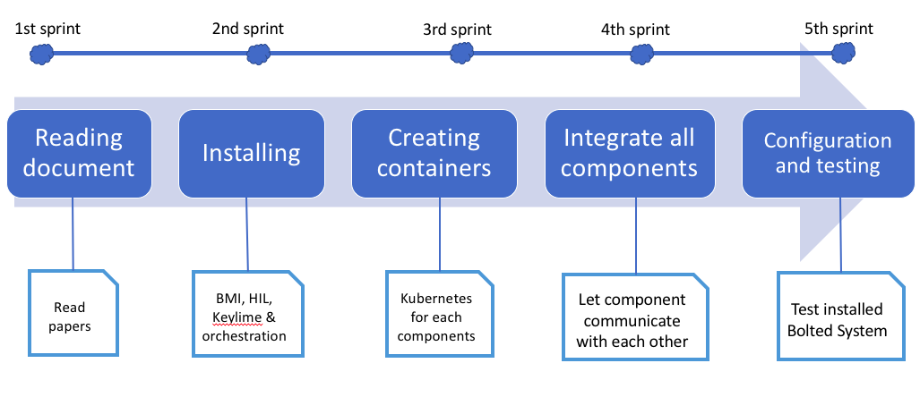
Project Plan

Slide 9
Responsibilities for next sprint
Installation of each component in this particular order - Keylime ( Vidya and Pei Jia), BMI (Jalon and Yuxi) and HIL (Everyone)
Automate the installation process using Ansible scripts. (Everyone)

Slide 10
Question ?

